Slide 1
ENTREPRENEURSHIP
Lecture No: 26
Resource Person:
Malik Jawad Saboor
Assistant Professor
Department of Management Sciences
COMSATS Institute of Information Technology
Islamabad.

Slide 2

Previous Lecture Review
One-to-One Marketing
Customer Sensitivity
Guerilla Marketing
Competitive Advantage Development through Customer Focus, Quality, Convenience, Innovation, Service & Speed
Benefits of Selling on Web

Slide 3

Advantages of Intrapreneuring over Entrepreneuring
Capital Sources
Access to customers
Infrastructure
Management Pools
Leverage on an existing business

Slide 4

Disadvantages of Intrapreneuring over Entrepreneuring
Continuity of Sponsorship
P & L Focus
Short Term Mentality
Corporate Meddling, Bureaucracy, Decision by committee
Lack of Passion
Have to be big to be material
Aversion to risk

Slide 5
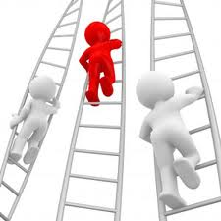
How companies can support the process
Shorten the search for funding
Offer a stable pay check as an idea germinates
Find creative ways to reward employees and let them get rich from their creations
Can have longer time horizons than venture capitalists have
Allow people to speak their minds and proceed with their plans if they have sufficient evidence and arguments
Allow employees to take risks without fear of reprisals
Have a formal process for moving an idea from research to product to market.
Understand the right balance between structure and spontaneity

Slide 6

How companies can support Intrapreneurs
Formation of intrapreneurial teams and task forces;
Recruitment of new staff with new ideas;
Application of strategic plans that focus on achieving innovation; and
Establishment of internal research and development programs are likely to see tangible results

Slide 7

OBJECTIVES
Stakeholder’s Management

Slide 8
Stakeholder in Lexical Terms

Slide 9

How companies can support Intrapreneurs
Support from top level management –
This support should not simply consist of passive approval of innovative ways of thinking. Ideally, it should also take the form of active support, such as can be seen in mentoring relationships.
Recognition that the style of intrapreneurialism that is encouraged needs to be compatible with business operations and the organization's overall culture.
Ensure that communication systems within the company are strong so that intrapreneurs who have new ideas for products or processes can be heard.
Intelligent allocation of resources to pursue intrapreneurial ideas

Slide 10
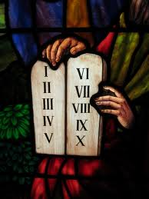
10 Commandments of Intrapreneurs
Do any job to make your project work, regardless of your job description
Share credit (for success) wisely
It is easier to ask for forgiveness than permission
Come to work each day willing to be fired
Ask for advice before asking for resources
Follow your intuition about people, build a team of the best
Build a quiet coalition for your idea; Never bet on a race unless your are running in it
Be true to your goals, but realistic about ways to achieve them
Honour your sponsors

Slide 11
What are Stakeholders?
Individuals and groups with a multitude of interests, expectations, and demands as to what business should provide to society

Slide 12
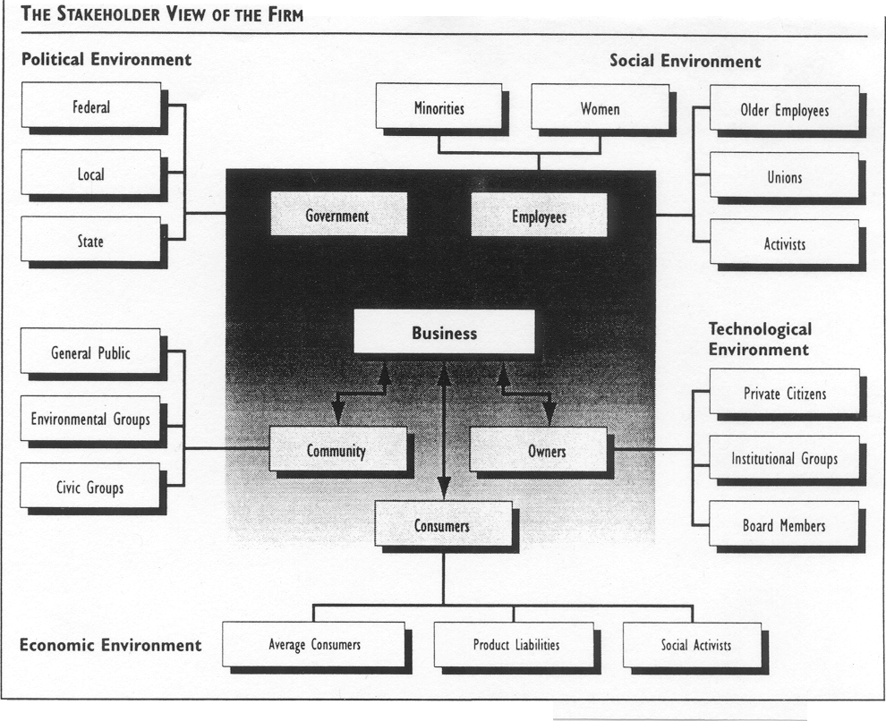
Who Are Business Stakeholders?

Slide 13
Types of Stake
Stakeholder/Responsibility Matrix
Stakeholders | Economic | Legal | Ethical | Philanthropic
Owners
Customers
Employees
Community
Public at large
Social Activists
Other

Slide 14

Power/Interest Grid
Two-by-two matrix with power on one axis and interest on the other
Each stakeholder is placed on the Grid based on its power and interest

Slide 15
Power/Interest Grid
Stakeholders Potential Threat to the Organisation
LOW
HIGH
HIGH
SUBJECTS
PLAYERS
Interest in the
Organisation
and its Activities
LOW
CROWD
CONTEXT SETTERS
Adapted from Eden & Ackerman, 1998
Notes:
If you are doing this as part of a strategy implementation, then first should show where people are at the moment relative to the firm and then show how this would be expected to change as a result of the change.

Slide 16
Strategies to tackle groups
Stakeholders Potential Threat to the Organisation
LOW
HIGH
SUBJECTS
Keep Satisfied
PLAYERS
Manage Closely
HIGH
Interest in the
Organisation
and its Activities
CROWD
Monitor (Minimum Effort)
CONTEXT SETTERS
Keep informed
LOW
Adapted from Eden & Ackerman, 1998
Notes:
If you are doing this as part of a strategy implementation, then first should show where people are at the moment relative to the firm and then show how this would be expected to change as a result of the change.

